Slide 1
YOLO Model
https://www.youtube.com/watch?v=IfRMV2MY9n0&list=RDCMUCh9nVJoWXmFb7sLApWGcLPQ&index=2
https://www.youtube.com/watch?v=NTnZgLsk_DA
https://www.youtube.com/watch?v=Xx9X4xHE-N4
https://www.madrasresearch.org/post/step-by-step-yolo-algorithm

Slide 2
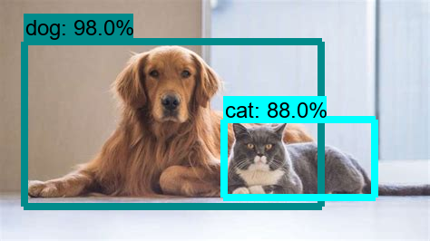
What is Object Detection?

Slide 3
Object Detection Overview
To explore the concept of object detection it is useful to begin with image classification. Image Classification goes through levels of incremental complexity.
Image classification (1) aims at assigning an image to one of a number of different categories (e.g. car, dog, cat, human, etc.), essentially answering the question “What is in this picture?”. One image has only one category assigned to it.
Object localization (2) then allows us to locate our object in the image, so our question changes to “What is it and where it is?”.
In a real real-life scenario, we need to go beyond locating just one object but rather multiple objects in one image.
For example, a self-driving car has to find the location of other cars, traffic lights, signs, humans and to take appropriate action based on this information.
Object detection (3) provides the tools for doing just that – finding all the objects in an image and drawing the so-called bounding boxes around them.
There are also some situations where we want to find exact boundaries of our objects in the process called instance segmentation, but this is a topic for another post.

Slide 4


Slide 5
How is YOLO different?
YOLO is different from all these methods as it treats the problem of image detection as a regression problem rather than a classification problem and supports a single convolutional neural network to perform all the above mentioned tasks.
The unification of all the independent tasks into one network has the following benefits:
SPEED: YOLO is extremely fast compared to its predecessors as it uses a single convolution network to detect objects. The convolution is performed on the entire input image only once to yield the predictions.
LESS BACKGROUND MISTAKES: YOLO performs the convolution on the whole image rather than sections of it due to which it encodes contextual information about the classes and their appearances.
It makes less mistakes in predicting background patches as objects as it views the entire image and reasons globally rather than locally.
HIGHLY GENERALIZABLE: YOLO learns generalizable representations of objects due to which it can be applied to new domains and unexpected inputs without breaking

Slide 6
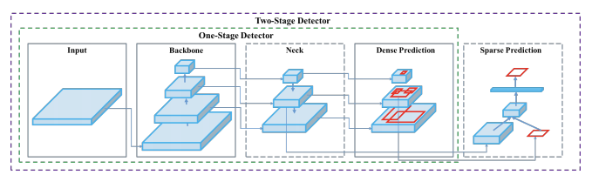
The YOLO network consists of three main pieces.
1) Backbone - A convolutional neural network that aggregates and forms image features at different granularities.
2) Neck - A series of layers to mix and combine image features to pass them forward to prediction.
3) Head - Consumes features from the neck and takes box and class prediction steps.

Slide 7
What is YOLO object detection?
As mentioned already, YOLO which stands for “You only look once” is a single shot detection algorithm which was introduced by Joseph Redmon in May 2016.
Although the name of the algorithm may sound strange, it gives a perfect description of this algorithm as it predicts classes and bounding boxes for the whole image in one run of the algorithm.
YOLO performed surprisingly well as compared to the other single-shot detectors of that time in terms of speed and accuracy.
It is not the most accurate algorithms when it comes to object detection but certainly, it makes that up with its impressive speed and thus is a good balance between speed and accuracy.

Slide 8
Overview of YOLO object detection algorithm
The YOLO network splits the input image into a grid of S×S cells.
If the center of the ground truth box falls into a cell, that cell is responsible for detecting the existence of that object.
Each grid cell predicts B number of bounding boxes and their objectness score along with their class predictions as follows:
Coordinates of B bounding boxes -YOLO predicts 4 coordinates for each bounding box (bx,by,bw,bh) with respect to the corresponding grid cell.
Here bx, by are the x and y coordinates of the midpoint of the object with respect to this grid.
The value of bh is the ratio of the height of the bounding box to the height of the corresponding grid cell and bw is the ratio of the width of the bounding box to the width of the grid cell.
objectness score (P0) – indicates the probability that the cell contains an object.
The objectness score is passed through a sigmoid function to be treated as a probability with a value range between 0 and 1.
Class prediction – if the bounding box contains an object, the network predicts the probability of K number of classes. Where K is the total number of classes in your problem.

Slide 9
How does Object Detection work?
There are a few different algorithms for object detection and they can be split into two groups:
Algorithms based on classification. They are implemented in two stages. First, they select regions of interest in an image.
Second, they classify these regions using convolutional neural networks.
This solution can be slow because we have to run predictions for every selected region.
A widely known example of this type of algorithm is the Region-based convolutional neural network (RCNN) and its cousins Fast-RCNN, Faster-RCNN and the latest addition to the family: Mask-RCNN.
Algorithms based on regression – instead of selecting interesting parts of an image, they predict classes and bounding boxes for the whole image in one run of the algorithm.
The two best known examples from this group are the YOLO (You Only Look Once) family algorithms and SSD (Single Shot Multibox Detector).
They are commonly used for real-time object detection as, in general, they trade a bit of accuracy for large improvements in speed.

Slide 10
Faster-RCNN
Faster-RCNN variants are the popular choice of usage for two-shot models.
Here during the region proposal stage, we use a network such as ResNet50 as a feature extractor.
We do this by removing the last layers of this network and just use the rest of the layers to extract features from the images.
This is usually a better approach as the network is already trained and can extract features from the images.
Next, a small fully connected network slides over the feature layer to predict class-agnostic box proposals, with respect to a grid of anchors tiled in space, scale and aspect ratio.
In the second stage, these box proposals are used to crop features from the intermediate feature map which was already computed in the first stage.
The proposed boxes are fed to the remainder of the feature extractor in which the prediction and regression heads are added on top of the network.
Finally, in the output, we get the class and class-specific box refinement for each proposal box.

Slide 11
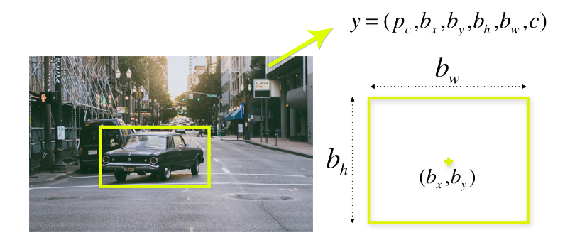
YOLO algorithm
To understand the YOLO algorithm, it is necessary to establish what is actually being predicted. Ultimately, we aim to predict a class of an object and the bounding box specifying object location.
Each bounding box can be described using four descriptors:
center of a bounding box (bxby)
width (bw)
height (bh)
value cis corresponding to a class of an object (such as: car, traffic lights, etc.).
In addition, we have to predict the pc value, which is the probability that there is an object in the bounding box.

Slide 12
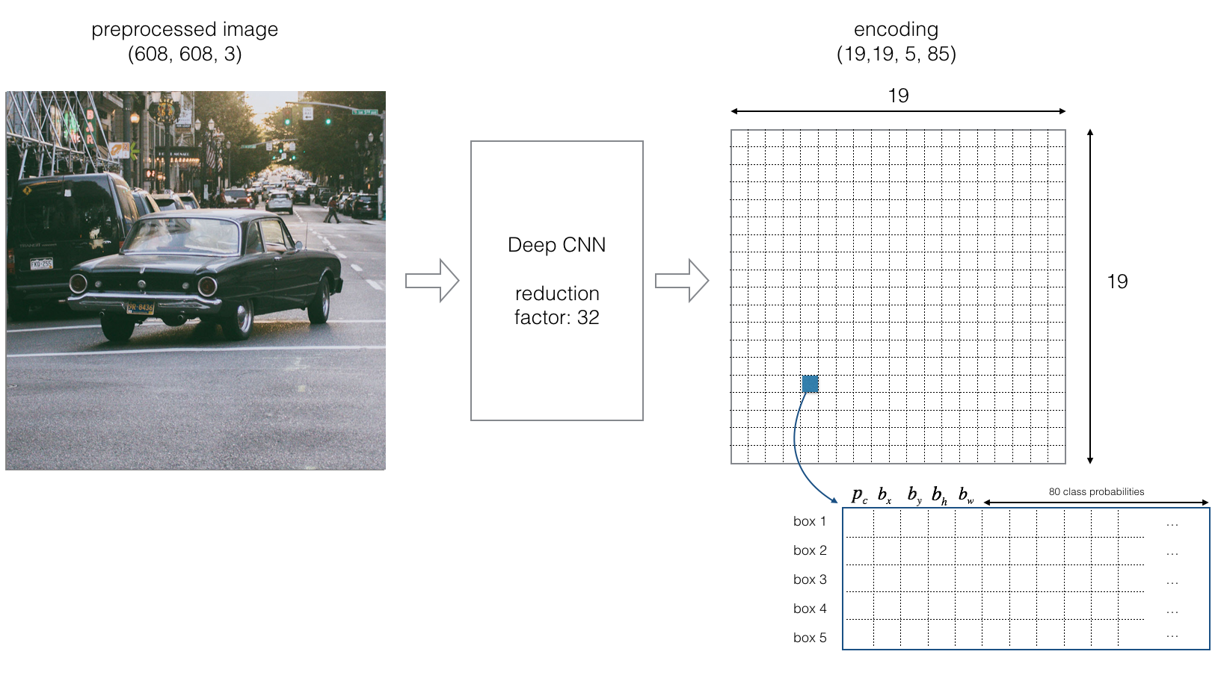
As we mentioned above, when working with the YOLO algorithm we are not searching for interesting regions in our image that could potentially contain an object.
Instead, we are splitting our image into cells, typically using a 19×19 grid.
Each cell is responsible for predicting 5 bounding boxes (in case there is more than one object in this cell).
Therefore, we arrive at a large number of 1805 bounding boxes for one image.

Slide 13
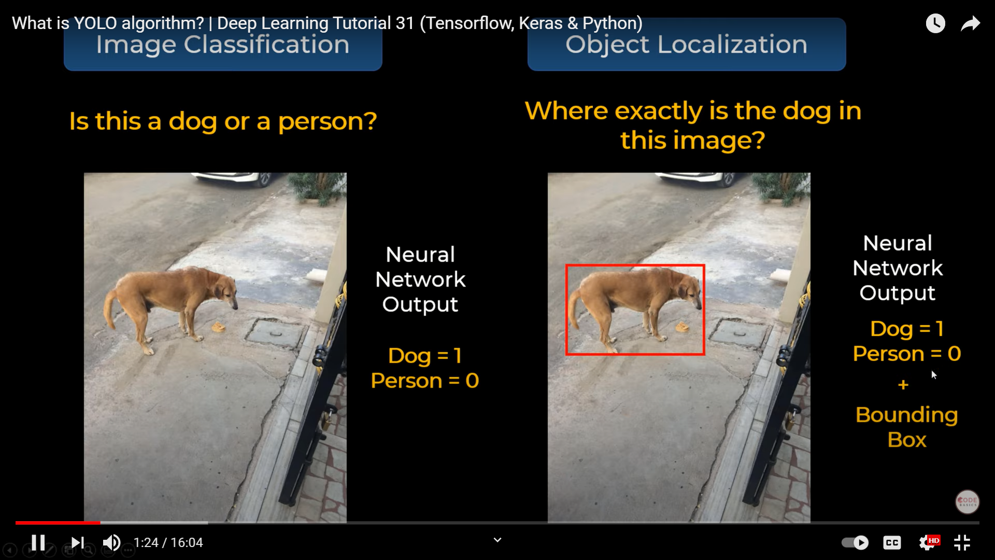

Slide 14
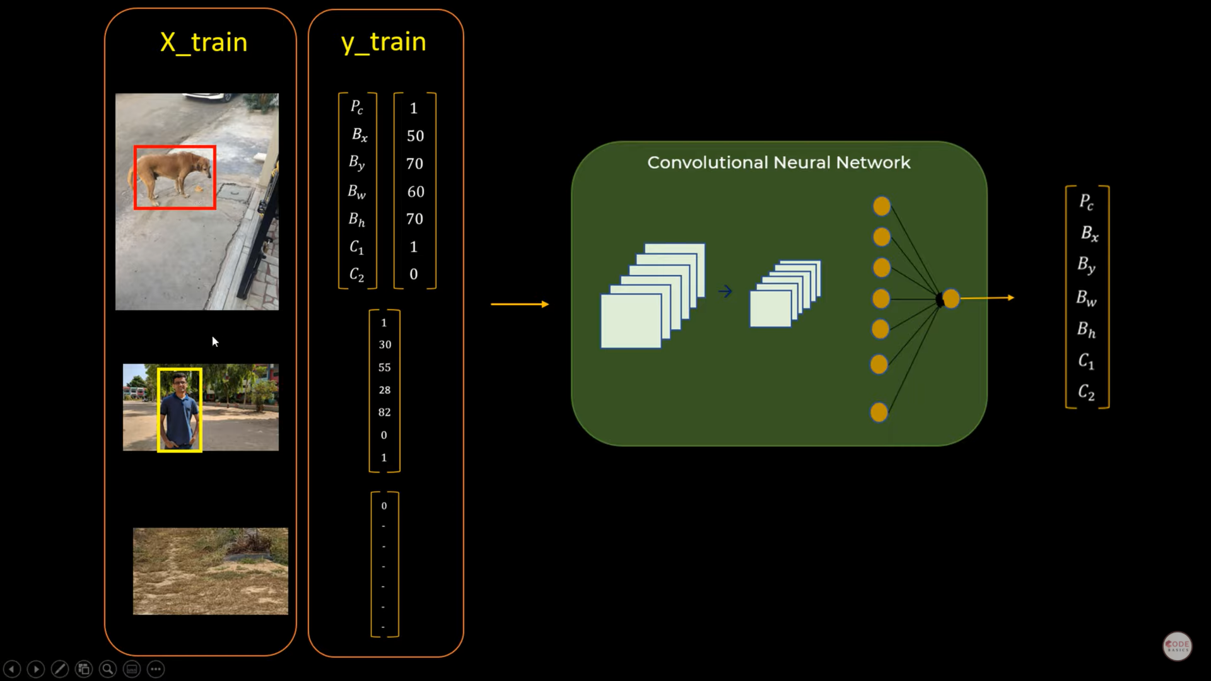

Slide 15
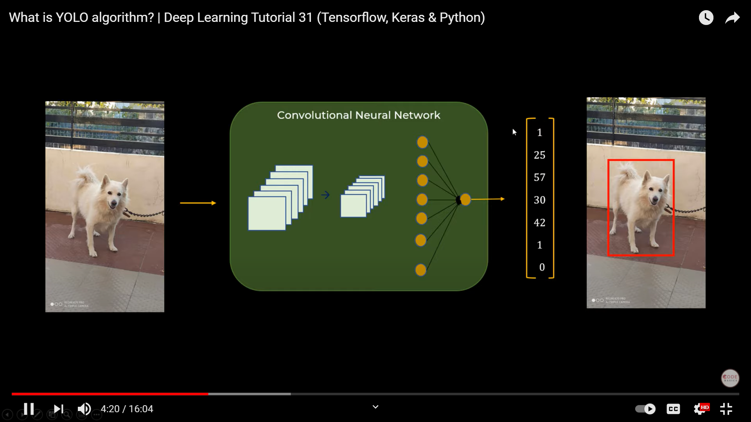
One object in Image

Slide 16
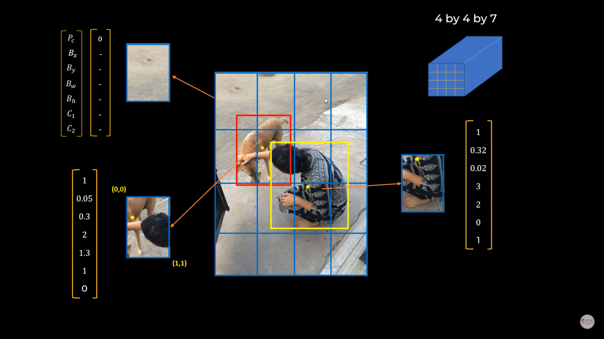

Slide 17
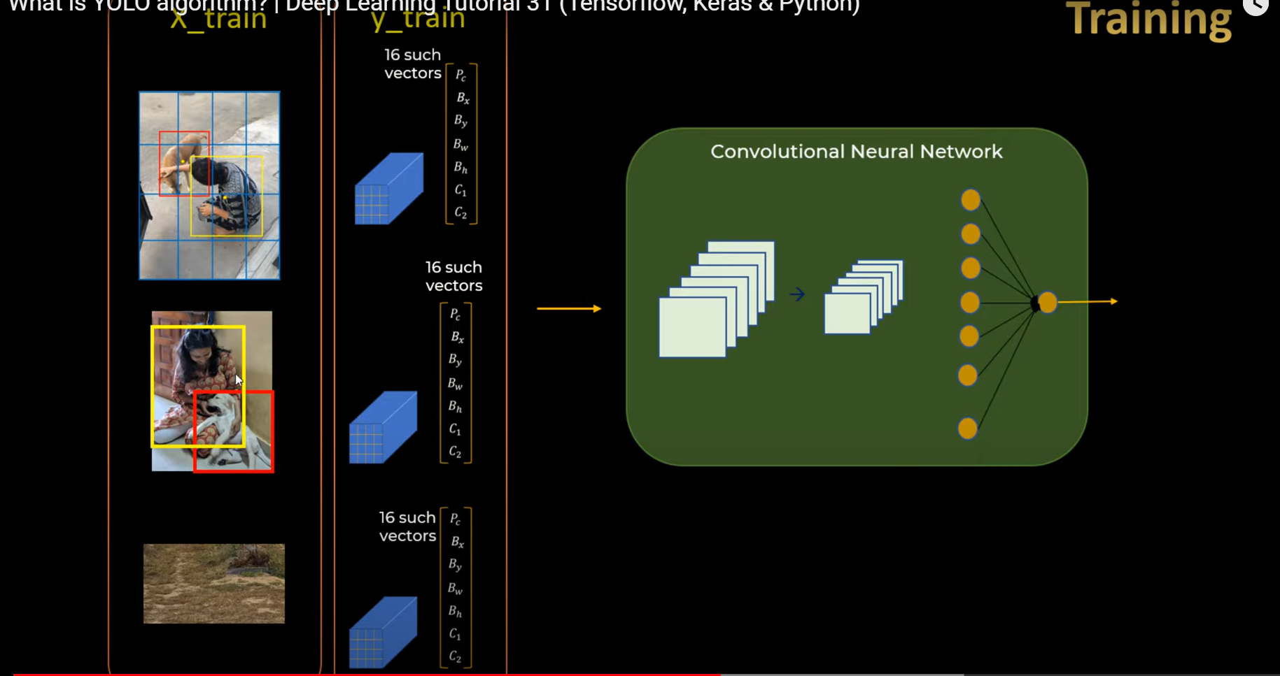

Slide 18
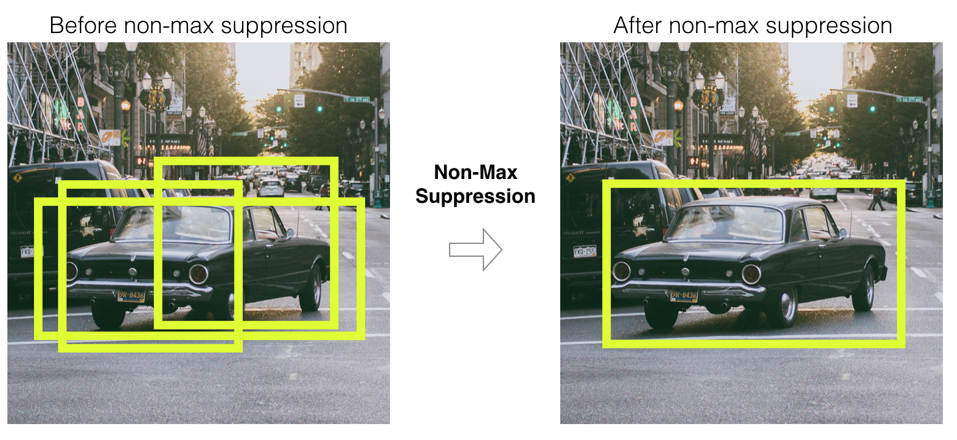
Most of these cells and bounding boxes will not contain an object. Therefore, we predict the value pc, which serves to remove boxes with low object probability and bounding boxes with the highest shared area in a process called non-max suppression.

Slide 19
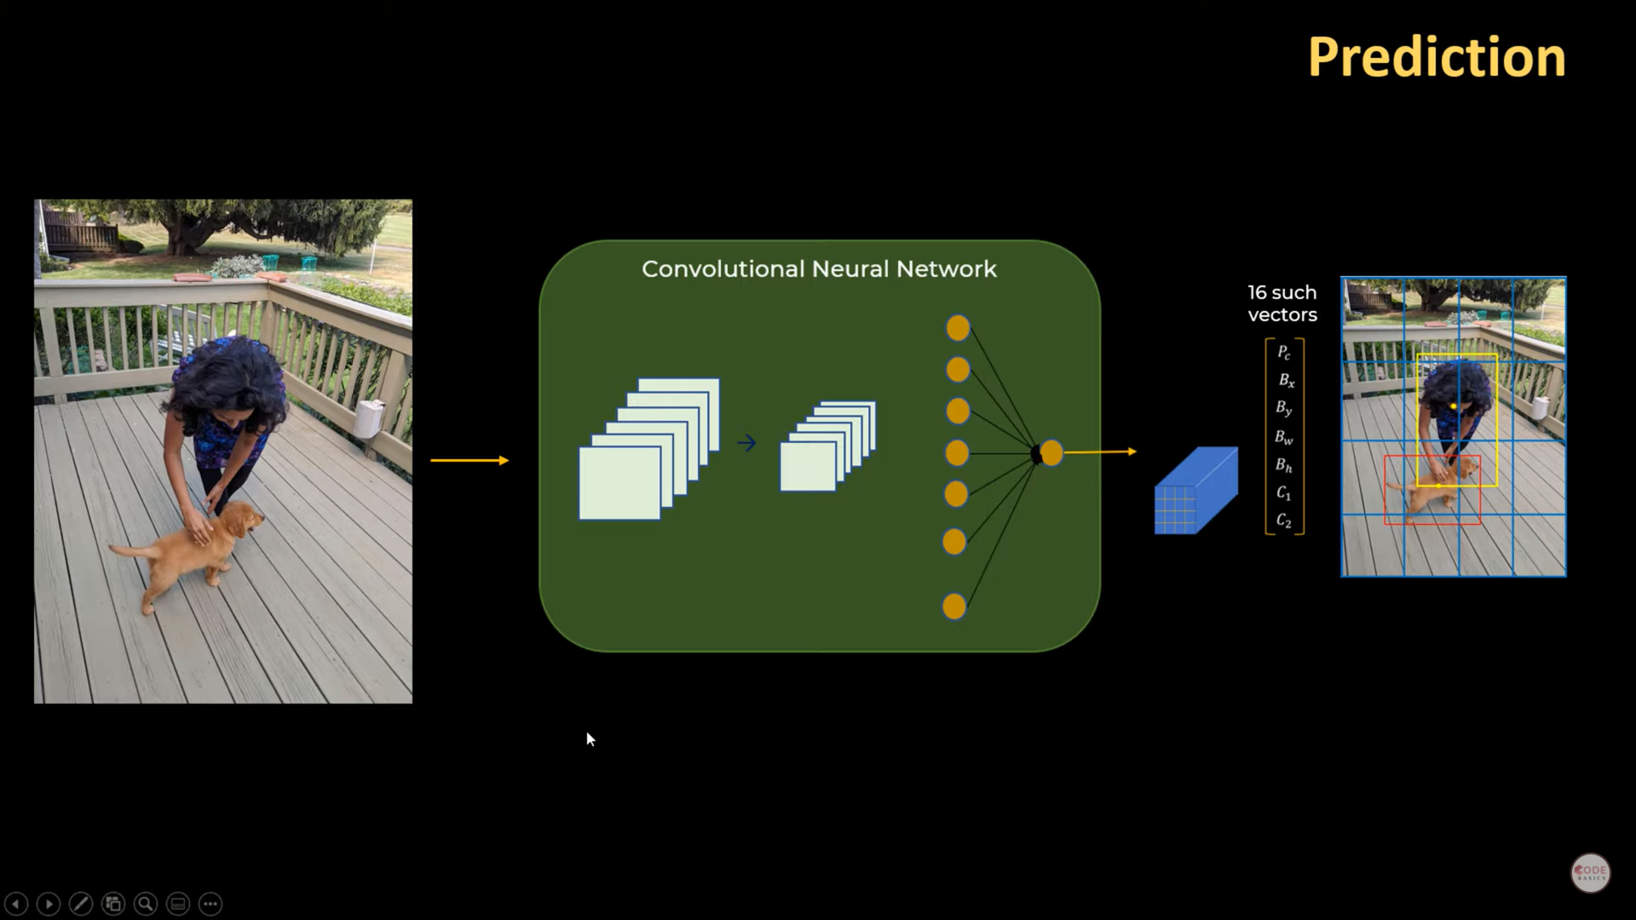

Slide 20
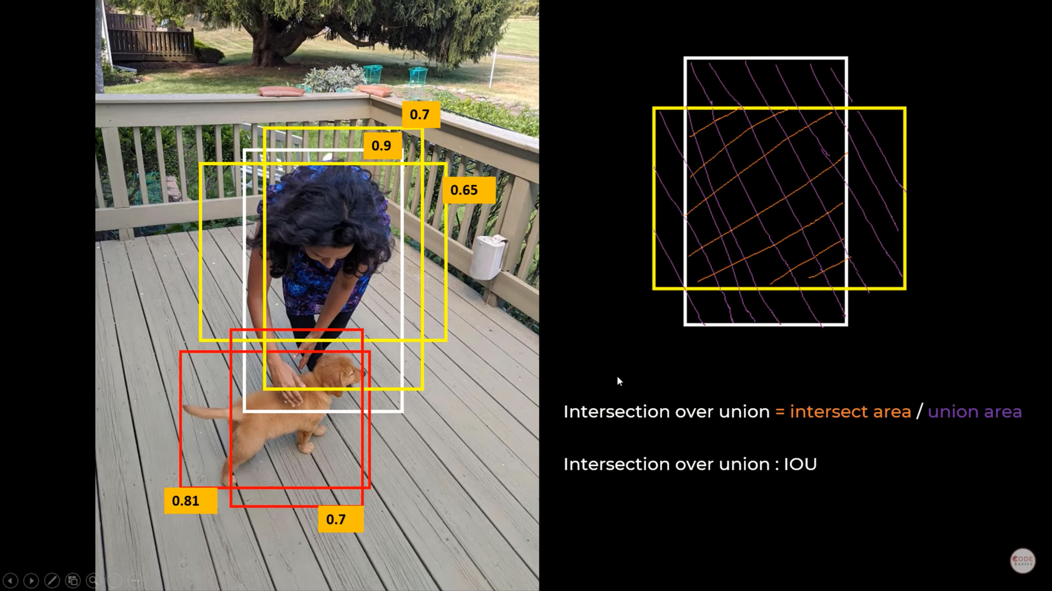

Slide 21
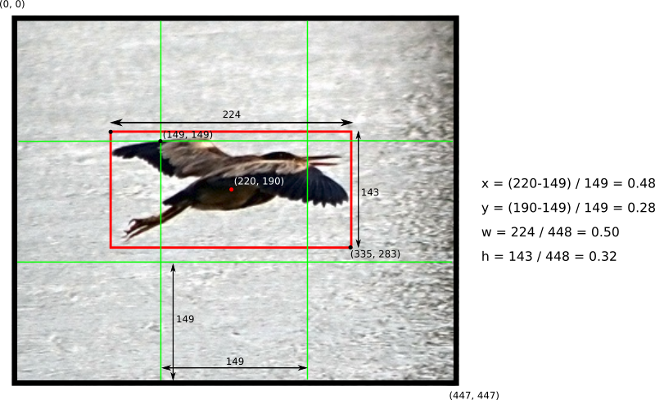
Example of how to calculate box coordinates in a 448x448 image with S=3. Note how the (x,y) coordinates are calculated relative to the center grid cell

Slide 22
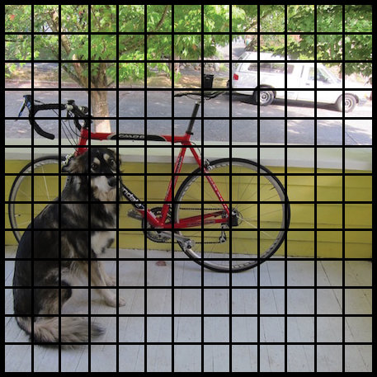
The YOLO network splits the input image into a grid of S×S cells.

Slide 23
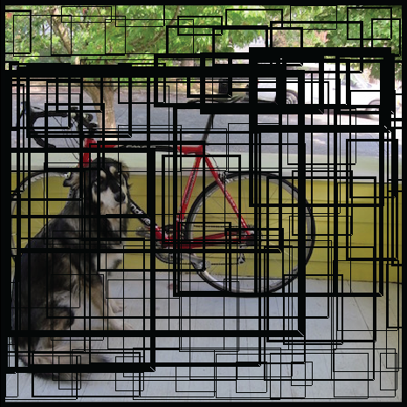
Each grid cell predicts B number of bounding boxes and their objectness score along with their class predictions as follows:
The predicted bounding boxes may look something like the following (the higher the confidence score, the fatter the box is drawn):

Slide 24
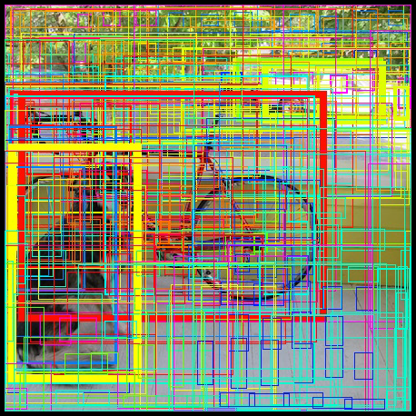
Finally, the confidence score for the bounding box and the class prediction are combined into one final score that tells us the probability that this bounding box contains a specific type of object.
For example, the big fat yellow box on the left is quite sure it contains the object “dog”:

Slide 25
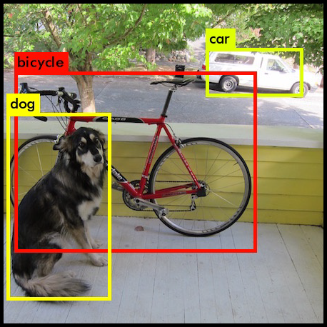
It turns out that most of these boxes will have very low confidence scores, so we only keep the boxes whose final score is above some threshold.
Also, Non-maximum Suppression (NMS) intends to cure the problem of multiple detections of the same image. In the next section, we will briefly go over it. The final prediction is then:

Slide 26
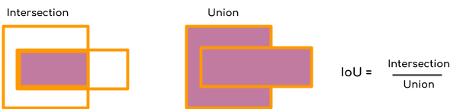
Non-maximum Suppression
Non-maximum Suppression or NMS uses the very important function called “Intersection over Union”, or IoU. Here is how we calculate IoU.
We define a box using its two corners (upper left and lower right): (x1, y1, x2, y2) rather than the midpoint and height/width. Next, we also need to find the coordinates (xi1, yi1, xi2, yi2) of the intersection of two boxes where :
xi1 = maximum of the x1 coordinates of the two boxes
yi1 = maximum of the y1 coordinates of the two boxes
xi2 = minimum of the x2 coordinates of the two boxes
yi2 = minimum of the y2 coordinates of the two boxes
Note that to calculate the area a rectangle (or a box) we can to multiply its height (y2 – y1) by its width (x2 – x1).
So to calculate IoU, first calculate the area of intersection by this formula
area_intersection =(xi2 - xi1)*(yi2 - yi1)
Next, calculate the area of union
union _area = (area of box 1 + area of box 2) - area_intersection
Therefore IoU=area_intersection/union_area

Slide 27
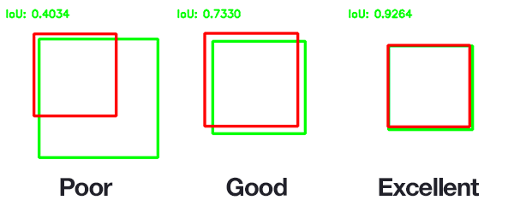
An example of computing Intersection over Unions for various bounding boxes.

Slide 28
Now, to implement non-max suppression, the steps are:
Select the box that has the highest score.
Compute its overlap with all other boxes, and remove boxes that overlap it more than a certain threshold which we call iou_threshold.
Go back to step 1 and iterate until there are no more boxes with a lower score than the currently selected box
These steps will remove all boxes that have a large overlap with the selected boxes. Only the best boxes remain.

Slide 29
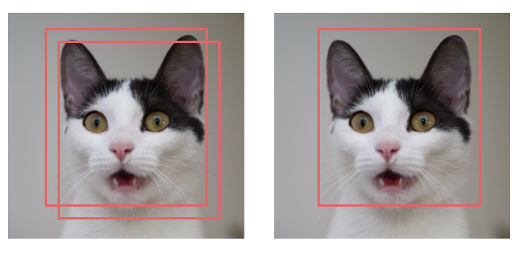
Before and after applying NMS

Slide 30
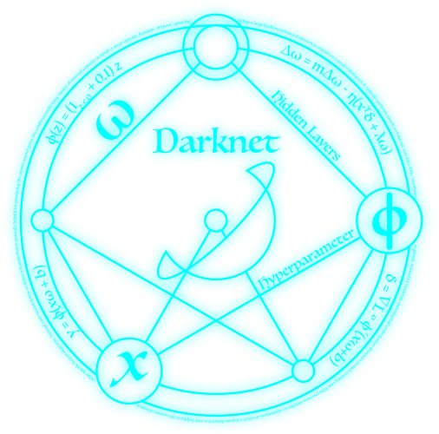
Darknet – a YOLO implementation
There are a few different implementations of the YOLO algorithm on the web.
Darknet is one such open source neural network framework
Darknet was written in the C Language and CUDAtechnology, which makes it really fast and provides for making computations on a GPU, which is essential for real-time predictions.
https://pjreddie.com/darknet/install/

Slide 31
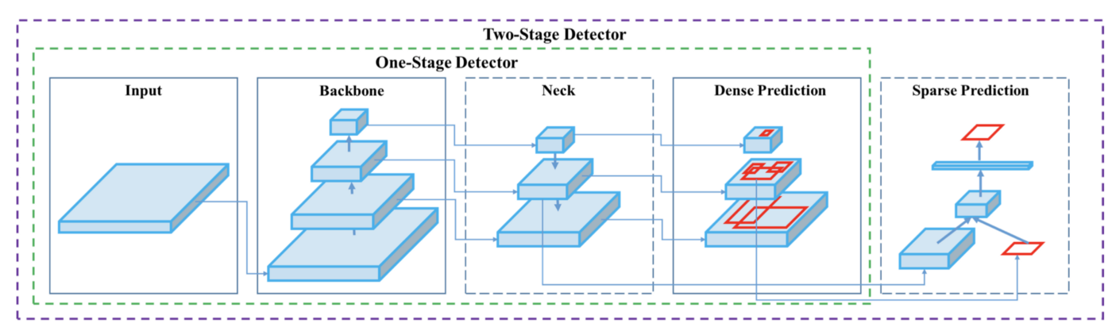
Architecture
Architecture

Slide 32
We have 4 apparent blocks, after the input image:
Backbone
Neck
Dense Prediction—used in one-stage-detection algorithms such as YOLO, SSD, etc
Sparse Prediction—used in two-stage-detection algorithms such as Faster-R-CNN, etc.

Slide 33
Backbone
Backbone here refers to the feature-extraction architecture. If you’re used to YOLO, you might know it by different names, such as Tiny YOLO or Darknet53. The difference between these is the backbone.
Tiny YOLO has only 9 convolutional layers, so it’s less accurate but faster and better suited for mobile and embedded projects
Darknet53 has 53 convolutional layers, so it’s more accurate but slower.
Exactly like there are multiple versions of ResNet, there are multiple versions of YOLO, depending on the backbone.
In YOLOv4, backbones can be VGG, ResNet, SpineNet, EfficientNet, ResNeXt, or Darknet53

Slide 34
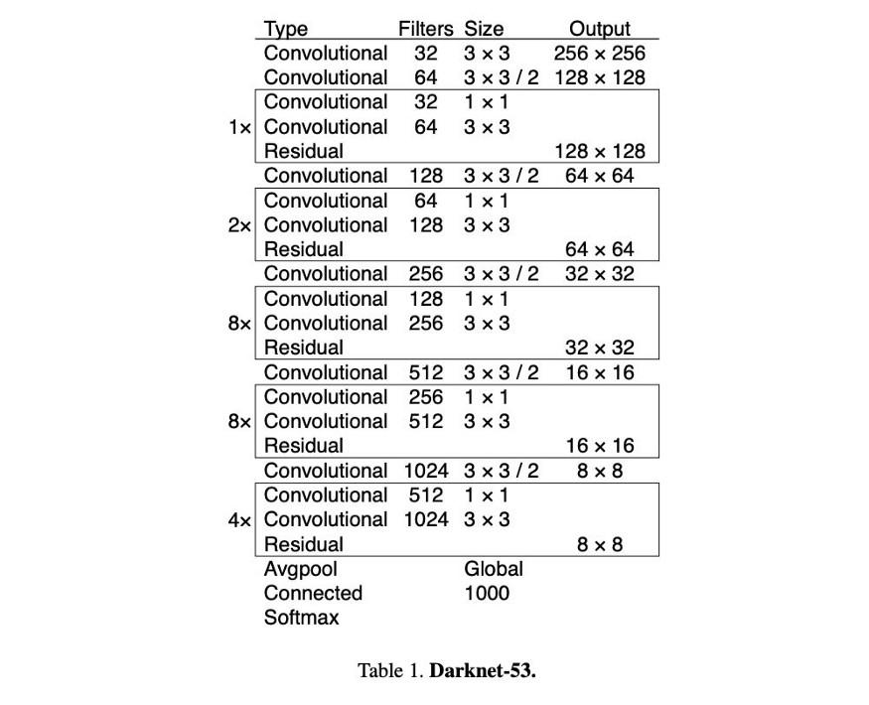
YOLO 4 Backbone

Slide 35
Neck
The purpose of the neck block is to add extra layers between the backbone and the head (dense prediction block). You might see that different feature maps from the different layers used.
Some techniques exist for adding information in a layer, a bit like a ResNet would do. YOLOv4 uses a modified Path Aggregation Network, a modified Spatial Attention Module, and Spatial Pyramid Pooling

Slide 36
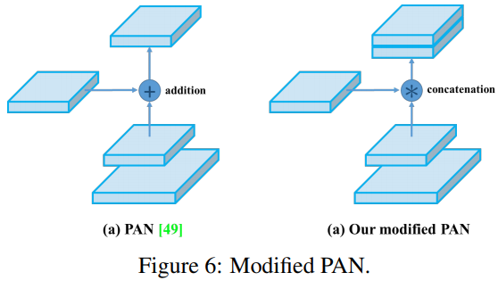
Path Aggregation Network
modified version of the PANet (Path Aggregation Network). The idea is again to aggregate information to get higher accuracy.

Slide 37
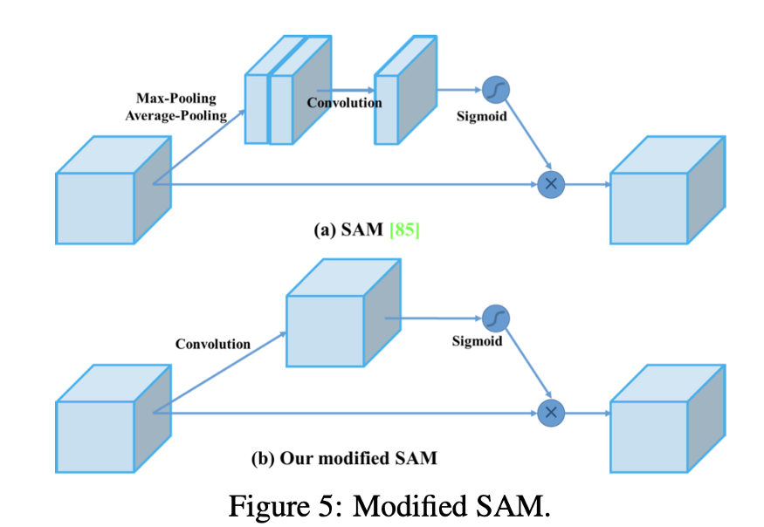
Spatial Attention Module (SAM).
Another technique used is Spatial Attention Module (SAM). Attention mechanisms have been widely used in deep learning, and especially in recurrent neural networks. It refers to focusing on a specific part of the input

Slide 38
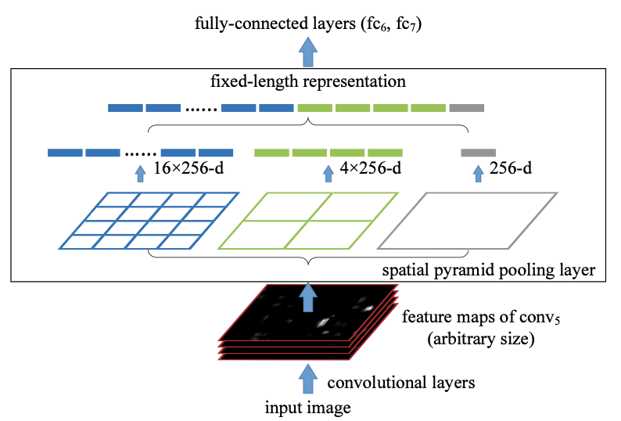
Spatial Pyramid Pooling (SPP),
Finally, Spatial Pyramid Pooling (SPP), used in R-CNN networks and numerous other algorithms, is also used here.

Slide 39
Head
The head block is the part used to:
Locate bounding boxes
Classify what’s inside each box
The network detects the bounding box coordinates (x,y,w,h) as well as the confidence score for a class. This technique is anchor-based. In case you need a refresher on how YOLO computes the prediction,
The goal of YOLO is to divide the image into a grid of multiple cells, and then for each cell predict the probability of having an object using anchor boxes. The output is vector with bounding box coordinates and probability classes. Post-processing techniques such as non-maxima suppression (NMS) are also used.

